Slide 1
Naïve Bayes Model and Directed Graphical Model
Akash Choudhuri
Roll: 2019D014
M.Sc (2nd Year), Mathematics with Data Science
Institute of Mathematics & Applications, Bhubaneswar
akashchoudhuri.ima@iomaorissa.ac.in

Slide 2
Outline
Conditional Independence and Bayes Theorem.
The Naïve Bayes Model.
Directed Graphical Models.
Bayesian Networks.
Application
Programmed Example (if time permits).

Slide 3
Conditional Independence and Bayes Theorem

Slide 4
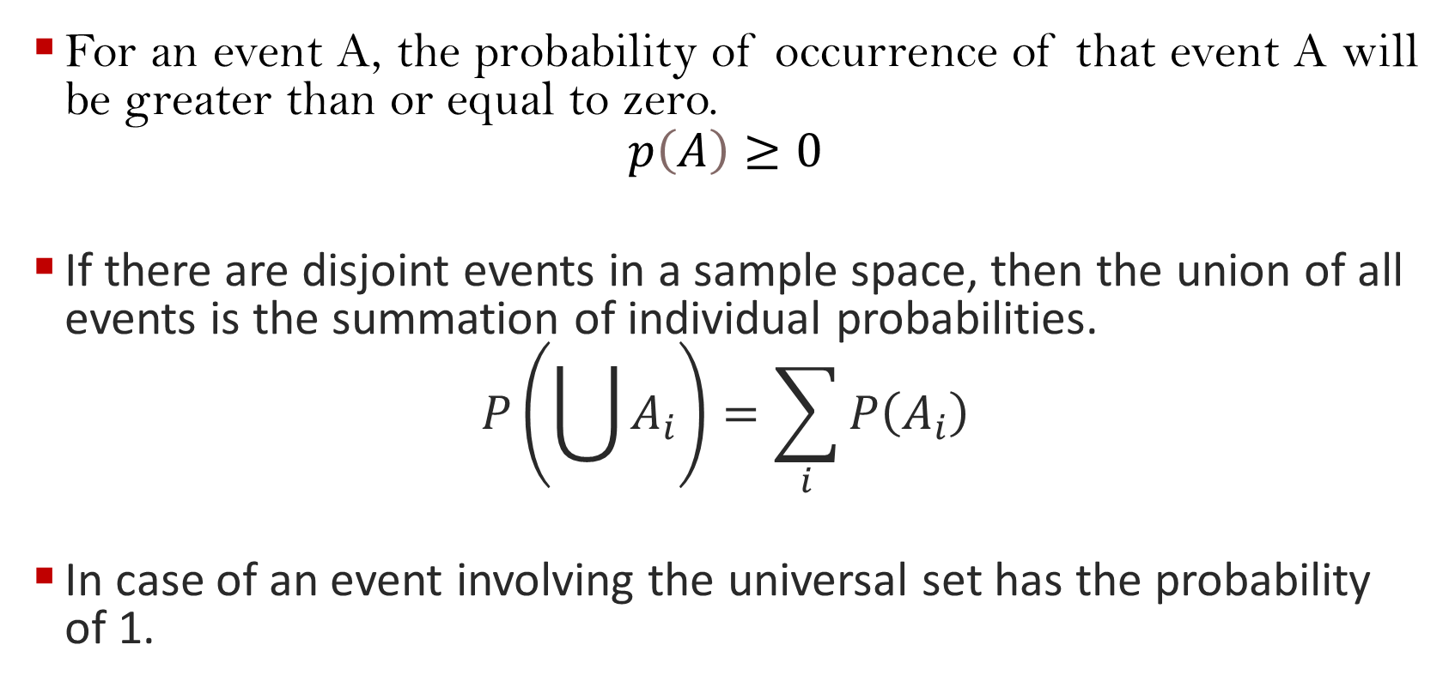
Axioms of Probability Theorem:
For an event A, the probability of occurrence of that event A will be greater than or equal to zero.
$$p\left(A\right)≥0$$
If there are disjoint events in a sample space, then the union of all events is the summation of individual probabilities.
$$P\left(\bigcup{A_{i}}\right)=\sum_{i}{P\left(A_{i}\right)}$$
In case of an event involving the universal set has the probability of 1.

Slide 5
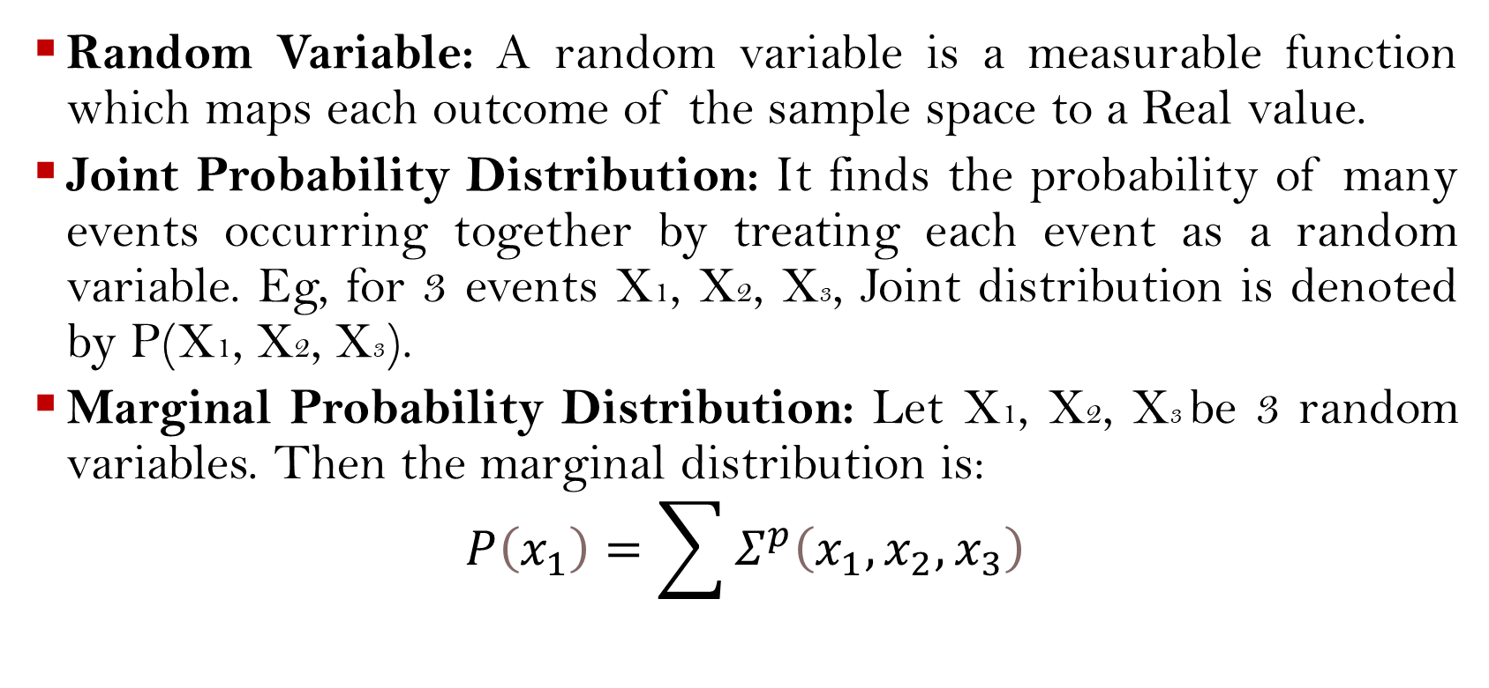
Important Concepts of Probability Theory
Random Variable: A random variable is a measurable function which maps each outcome of the sample space to a Real value.
Joint Probability Distribution: It finds the probability of many events occurring together by treating each event as a random variable. Eg, for 3 events X1, X2, X3, Joint distribution is denoted by P(X1, X2, X3).
Marginal Probability Distribution: Let X1, X2, X3 be 3 random variables. Then the marginal distribution is:
$$P\left(x_{1}\right)=\sum{Σ^{p}\left(x_{1},x_{2},x_{3}\right)}$$

Slide 6
Introduction to Bayes Theorem
Conditional Independence: We say an event X is conditionally independent of event Y given an event Z denoted as:
P(X|Y, Z) = P(X|Z).
Bayes Theorem: Principled way of calculating a conditional probability without the joint probability.
In simpler terms, the result P(A|B) is referred to as the posterior probability and P(A) is referred to as the prior probability. Sometimes P(B|A) is referred to as the likelihood and P(B) is referred to as the evidence. This allows Bayes Theorem to be restated as:
Posterior = Likelihood * Prior / Evidence

Slide 7
The Naïve Bayes Model

Slide 8
Why ‘naïve’?
This model uses Bayes Theorem with a small assumption that there is independence among predictors, ie, the presence of a particular feature in a class is unrelated to the presence of any other feature.
So, our Bayes Theorem formula is re-written by omitting the denominator (a littler bit of maths can show that and it reduces to:
By Bayes Theorem, P(B|A)=(P(A|B)*P(B))/P(A)
=P(A|B)*P(B)
Generalising the Equation,
P(c|X)=P(x1 |c)* P(x2 |c)* P(x3 |c)…… P(xn |c)*P(c)

Slide 9
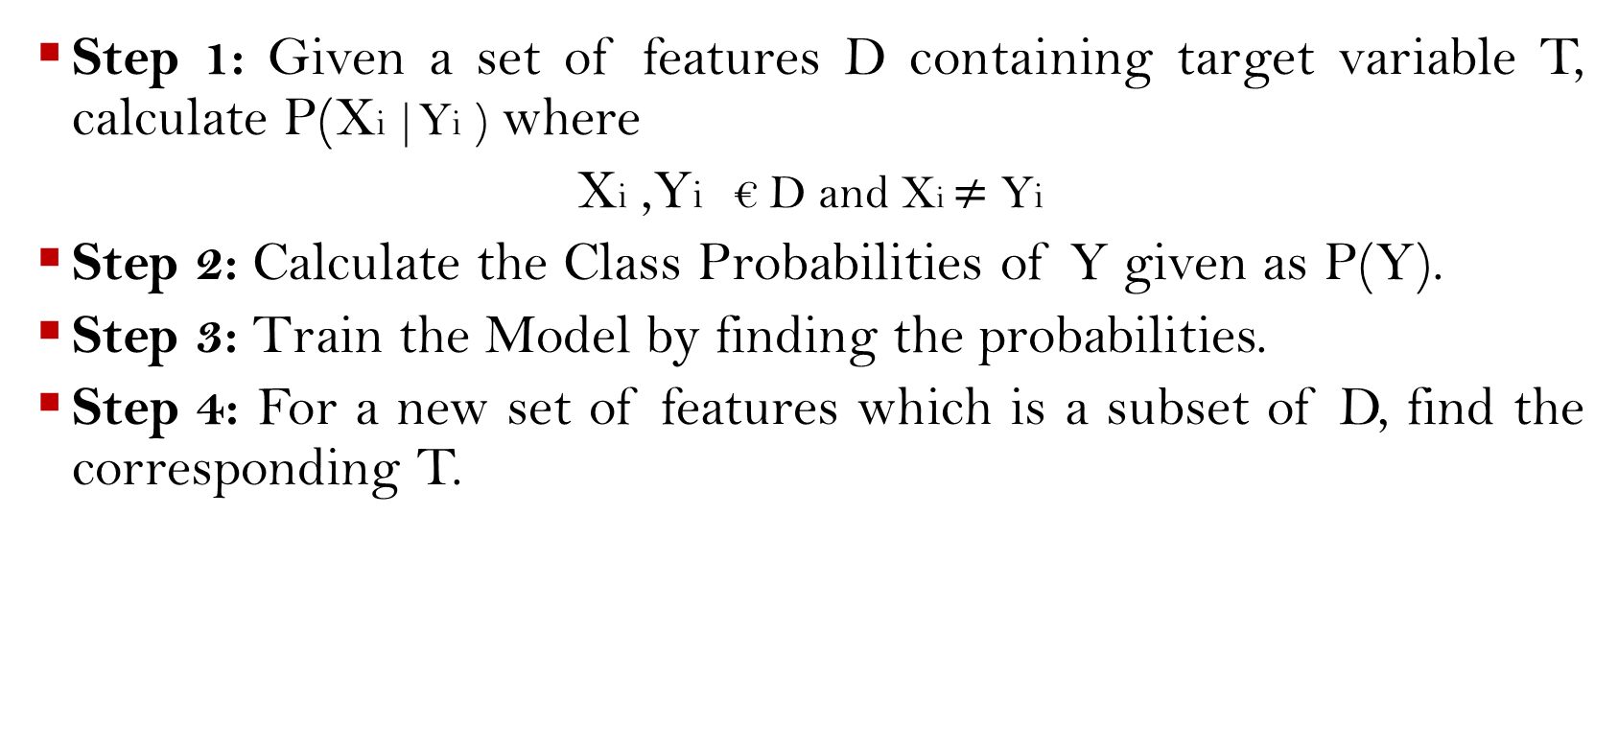
Naïve Bayes Classifier Algorithm for Discrete Data
Step 1: Given a set of features D containing target variable T, calculate P(Xi |Yi ) where
Xi ,Yi € D and Xi $≠$ Yi
Step 2: Calculate the Class Probabilities of Y given as P(Y).
Step 3: Train the Model by finding the probabilities.
Step 4: For a new set of features which is a subset of D, find the corresponding T.

Slide 10
Directed Graphical Models

Slide 11
Kinds of Graphical Models
Undirected Graphical Models also known as Markov Random Fields.
Directed graphical models also known as Bayesian (belief) networks. The important Characteristics of Bayesian Networks are:
Bayesian Networks require that the graph is a DAG (directed acyclic graphs).
No directed cycles allowed.

Slide 12
Bayesian Networks

Slide 13
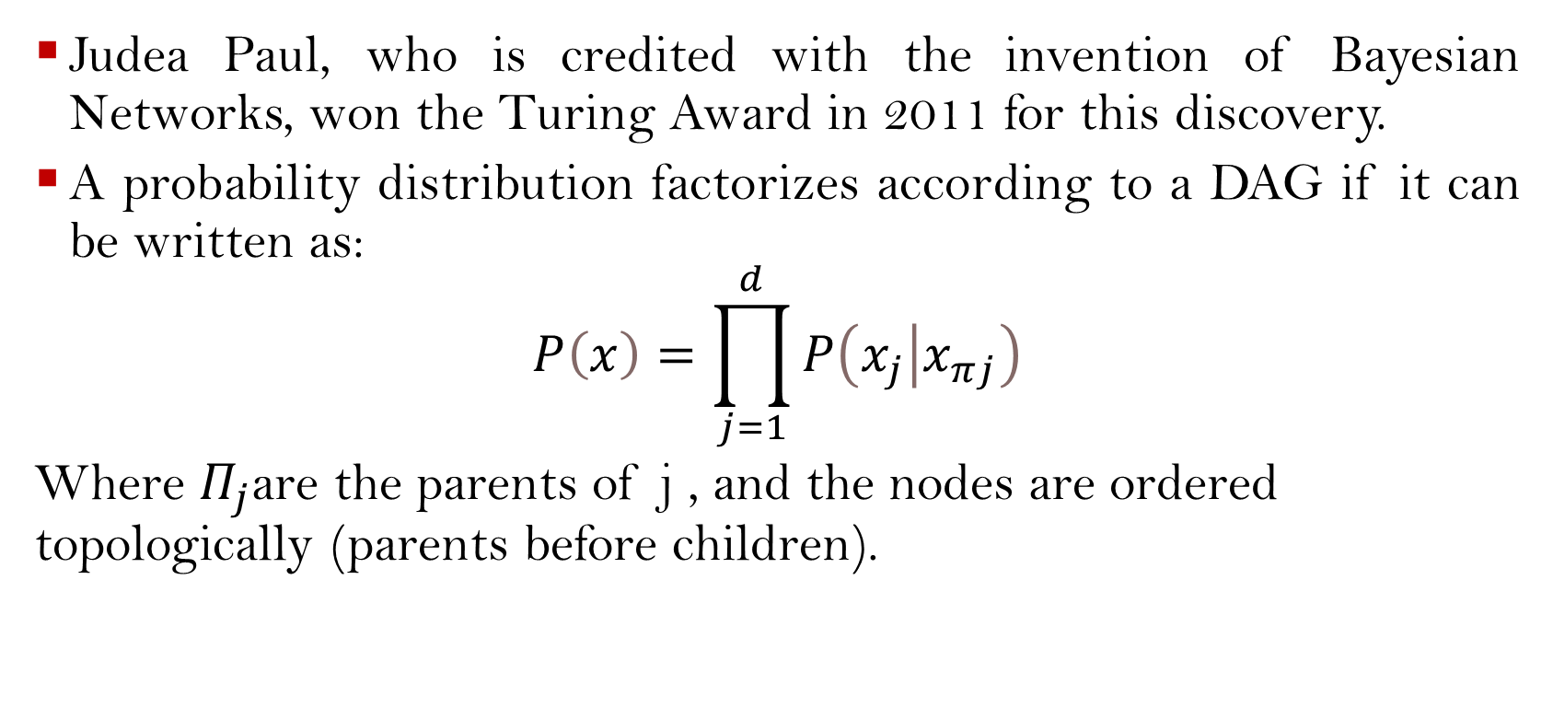
Bayesian Networks
Judea Paul, who is credited with the invention of Bayesian Networks, won the Turing Award in 2011 for this discovery.
A probability distribution factorizes according to a DAG if it can be written as:
$$P\left(x\right)=\prod_{j=1}^{d}{P\left(\left.x_{j}\right|x_{πj}\right)}$$
Where $Π_{j}$are the parents of j , and the nodes are ordered topologically (parents before children).

Slide 14
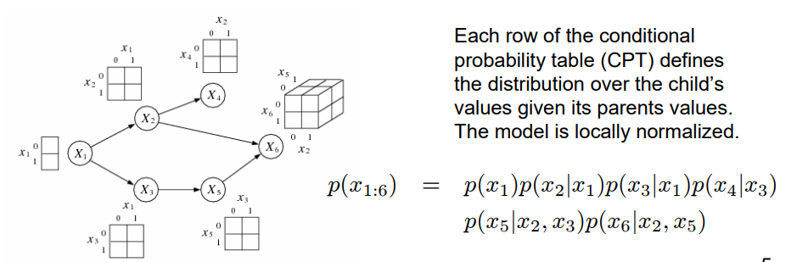
Continued….

Slide 15

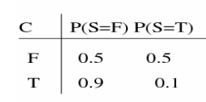
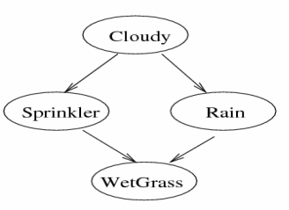
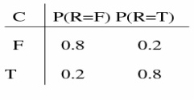
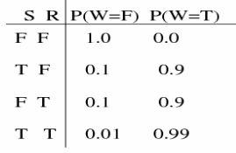
Example Bayesian Network

Slide 16
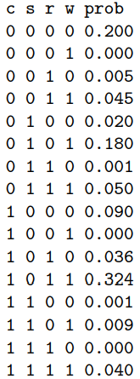


Continued
The joint distribution is computed using Naïve Bayes Model as:
p (C, S, R,W) = p (C) p (S|C) p (R|C) p (W|S, R)
Prior that sprinkler is on:
Posterior that sprinkler is on given that grass is wet:

Slide 17
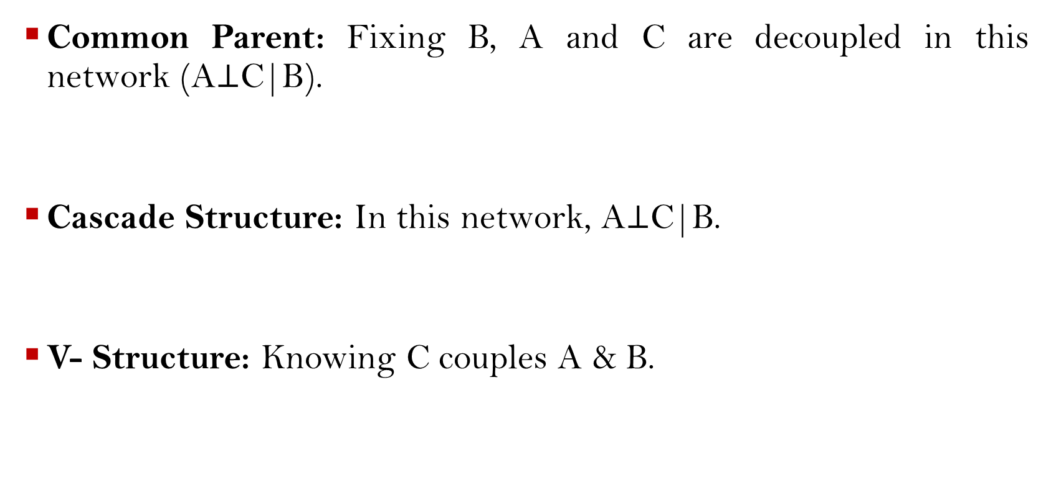
Conditional Independencies Implied from Bayesian Networks
Common Parent: Fixing B, A and C are decoupled in this network (A$⊥$C|B).
Cascade Structure: In this network, A$⊥$C|B.
V- Structure: Knowing C couples A & B.
B
A
C
A
B
C
A
B
C

Slide 18
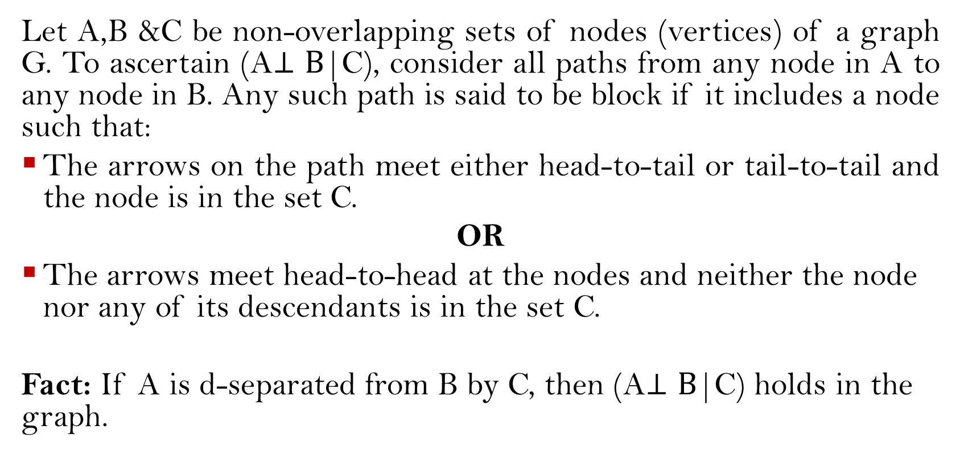
D- Separation
Let A,B &C be non-overlapping sets of nodes (vertices) of a graph G. To ascertain (A$⊥B$|C), consider all paths from any node in A to any node in B. Any such path is said to be block if it includes a node such that:
The arrows on the path meet either head-to-tail or tail-to-tail and the node is in the set C.
OR
The arrows meet head-to-head at the nodes and neither the node nor any of its descendants is in the set C.
Fact: If A is d-separated from B by C, then (A$⊥B$|C) holds in the graph.

Slide 19
Application

Slide 20
A Bayesian Network Model for Predicting Post stroke Outcomes With Available Risk Factors
An inference engine was constructed for post-stroke outcomes based on Bayesian network classifiers.
The prediction system that was trained on data of 3,605 patients with acute stroke forecasts the functional independence at 3 months and the mortality 1 year after stroke.
Feature selection methods were applied to eliminate less relevant and redundant features from 76 risk variables.
Bayesian network with selected features by wrapper-type feature selection can predict 3-month functional independence with an AUC of 0.889 using only 19 risk variables and 1-year mortality with an AUC of 0.893 using 24 variables.

Slide 21
Dataset
During admission, all patients were thoroughly investigated for medical history, clinical manifestations, and the presence of vascular risk factors.
All registered patients underwent brain imaging studies including brain computed tomography (CT) and/or MRI.
Stroke classification was determined during weekly conferences based on the consensus of stroke neurologists. Data including clinical information, risk factors, imaging study findings, laboratory analyses, and other special evaluations were collected. Along with these data, prognosis during hospitalization and long-term outcomes were also determined.

Slide 22
Methodology
76 Random variables were extracted from the data. Then a Bayesian Network was constructed using the formulae given before.
Given a data set D with variable Vi, the observed distribution PD is described as a joint probability distribution over D. The learning process now measures and compares the quality of Bayesian networks to evaluate how well the represented distribution explains the given data set. The log-likelihood is the basic common value used for measuring the quality of a Bayesian network as follows:

Slide 23
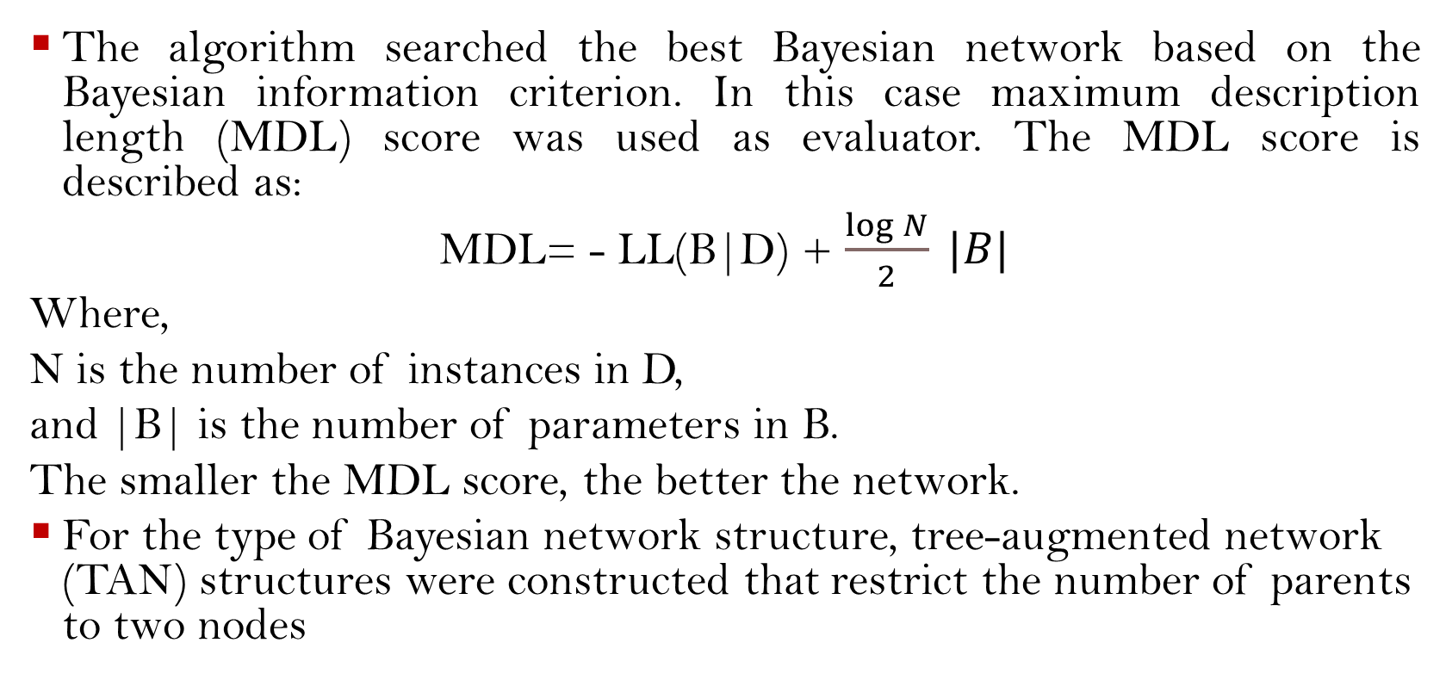
Methodology cont.
The algorithm searched the best Bayesian network based on the Bayesian information criterion. In this case maximum description length (MDL) score was used as evaluator. The MDL score is described as:
MDL= - LL(B|D) + $\frac{\log{N}}{2} |B|$
Where,
N is the number of instances in D,
and |B| is the number of parameters in B.
The smaller the MDL score, the better the network.
For the type of Bayesian network structure, tree-augmented network (TAN) structures were constructed that restrict the number of parents to two nodes

Slide 25
Results
Bayesian network for predicting functional independence at 3 months. The tree-augmented Bayesian network used 19 variables selected by the wrapper of the Bayesian network for prediction.

Slide 26
Results Cont.
Bayesian network for predicting 1-year mortality. The tree-augmented Bayesian network used 24 variables selected by the wrapper of the Bayesian network for prediction.

Slide 27
Performance Evaluations
Performance evaluation of Bayesian network-based classifiers: (A) performance of classifiers forecasting 90-day functional independence and (B) performance of classifiers for 1-year mortality prediction.

Slide 28
Programmed Example

Slide 29
References
https://www.kaggle.com/johnoliverjones/naive-bayesian-network-with-7-features/comments
https://www.kaggle.com/c/porto-seguro-safe-driver-prediction
https://www.cs.ubc.ca/~murphyk/Teaching/CS540-Fall08/L15DGM.pdf
https://www.frontiersin.org/articles/10.3389/fneur.2018.00699/full

Slide 30
Thank You
Questions/ Queries? Do reach out to me!

